Slide 1

BB: Booting Booster for Consumer Electronics with Modern OS
Geunsik Lim and MyungJoo Ham
Software R&D Center, Samsung Electronics
Apr-20-2016
Notes:
Thank you for the introduction. I am Geunsik Lim from Samsung Electronics. I am going to present booting booster for accelerating booting time of consumer electronics with modern OS. This study is done in corporation with MyungJoo Ham.
--- Security ------------------------------------------------ Global R&D Home / 논문등록번호: 150910-A-02
논문초록 결재 완결번호: EP-1FEA7A9D7166486F87E59BBBF242AE20
논문본문 결재 완결번호: EP-C140FE4BA44F4A878B3DE95C7F2EEF50
----------------------------------------------------------
- 작성 시나리오(총 17분): 소개/배경 10분 , 제안아이디어 4분, 데모/결론 3분
- We have 20 minute slots for each paper, which will be divided into 17 minutes for the talk and 3 minutes for Q&A. Since we are going to operate on a tight schedule, we ask you to pay particular attention to the timing during your rehearsals. - During the break before your talk, please check that your laptop works with the projector. This will also be a good opportunity to meet your session chair and mention any special requests you may have for the way he or she is going to introduce you. - We plan to make speakers' slides available on the conference website. After your talk, please email a copy of your slides (in PDF form) to eurosys16pcchairs@gsd.inesc-id.pt.

Slide 2
Fast Booting is Critical Requirement
Consumers desire shorter response time to user input for consumer electronics
Today, many seconds are required with modern smart TVs. Degeneration is usually incurred by increased number and complexity of software
To reduce booting time of consumer electronics, developers have used various approaches, including hibernation and suspend-to-RAM
With continuous power supply, device may use suspend-to-RAM, which stores all hardware states into RAM and keeps RAM powered
Notes:
Consumers desire shorter response time to user input for consumer electronics, including TV
Today, many seconds are required with modern smart TVs. Degeneration is usually incurred by increased number and complexity of software
To reduce the booting time of consumer electronics, developers have used various approaches, including hibernation and suspend-to-RAM
With a continuous power supply, device may use suspend-to-RAM, which stores all hardware states into RAM and keeps RAM powered

Slide 3
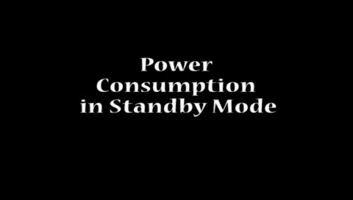
Customer Suspects Energy Efficiency
Video: High standby power consumption from some TV models
Notes:
Many Customers have suspected the energy efficiency of consumer electronics.
Let’s see the video file how customers check the power consumption of their device.
#### Video Play: within 20 s #####
Some digital TVs spend the power consumption in stand by mode up tol 20 or 30 watts.
As you can see, some customers have been utilizing the power estimator to check the real energy efficiency of their devices.

Slide 4

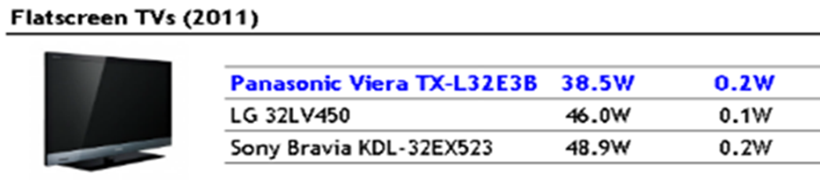
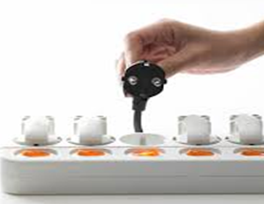
Customers Tackling Suspend-to-RAM
Consumers are sufficiently sensitive to energy consumption to unplug devices while not in use
GoPro Camera Models
(Unit: Watts)
 | HD | H2 | H3W | H3S | H3+S | H3B | H3+B | H4B
Standby Photo | 1.2 | 1.2 | 1.2 | 1.2 | 1.1 | 2.1 | 1.9 | 1.7
Standby Video | 1.2 | 1.2 | 1.2 | 1.7 | 1 | 2.1 | 1.3 | 1.7
Source - http://cam-do.com/GoProPower.html
Flatscreen TVs(2011)
(Unit: Watts)
Source - http://blogs.which.co.uk/technology/tvs/still-using-a-big-box-tv-why-the-energy-costs-may-make-you-think-again
Notes:
Consumers are very sensitive to energy consumption to unplug their devices while they are not in use
For example,
Camera device consumes the energy in standby mode. So, the customers try to turn the device off.
Flat-screen TV also consumes the energy in standby mode. They also try to turn the device off.
Like two cases, customers still want to save their money by turning the device completely off. Above all, customers think that consumer electronics consumes more power in standby mode.

Slide 5




Why is Cold Boot Important in CE?
Complaint of subsequent slower booting
Plug in & out
Source - http://www.etfguide.com/watch-out-the-stock-market-is-slow/
Notes:
Why is cold boot still important in consumer electronics?
Some customers make an effort to save their money by turning device off such as scrooges.
The sudden slow-boot of devices result from the turning device off by customers.
As a result of that, they complain of the subsequent slow booting time of their device.
we had to study the fast-boot technique based on the cold boot for them.
On the next page, let’s see the existing boot scheme’s limitation and hurdle.

Slide 6

Background
Booting Booster
Evaluation

Slide 7


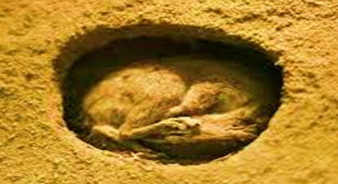
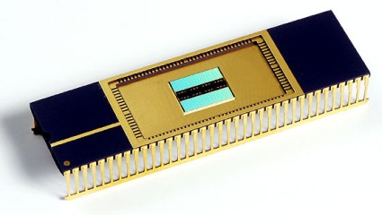
Techniques for Fast Boot
Technique | Strong Points | Weak Points
Slow
Cold Boot | Portability | Slow
Sleep (Suspend-to-Ram) | Fastest | Constant Power
Hibernation (Suspend-to-Disk) | Fast | Low Portability Less Dynamicity
NVRAM | Fastest | Cost
SAMSUNG
7
Source - http://www.1001freedownloads.com/free-icon/cat-sleep-icon
Notes:
사용자는 언제든 전원 플러그를 뽑거나 배터리를 뽑을 수 있고(이미지 생성 과정 방해), 스냅샷 이미지를 생성하는것은 시간이 오래 걸리는데, 이 시간동안 사용자는 장치를 이용할 수 없다.
어플리케이션 설치 혹은 종료 중에 수십초 동안(1분 이상일 경우) 응답이 없을 경우 이는 수십 초의 느린 부팅보다 훨씬 나쁘다.
There are 4 technical domains for fast boot in consumer electronics.
First is “cold boot” based on the power-on of devices.
Although it support portability for various embedded devices, In general, the booting time of the cod boot is slow more than the others.
Second is “sleep” approach based on “suspend-to-ram”.
Although it provide fastest booting time with the restoration of memory content, It has to keep the power supply condition.
Third is “hibernation” approach based on “suspend-to-disk”.
Although it does not need to keep power supply like sleep approach, It has low portability more than other approaches.
Last is “NVRAM” based on the “non-volatile memory”.
Even though it can do instant booting without any loading time of the application, it does not still ready to produce inexpensive NVRAM.
In our study, We focus on the accelerating the booting time of the devices based on the cold boot technique to resolve plug-out case of the suspend-to-ram technique.

Slide 8
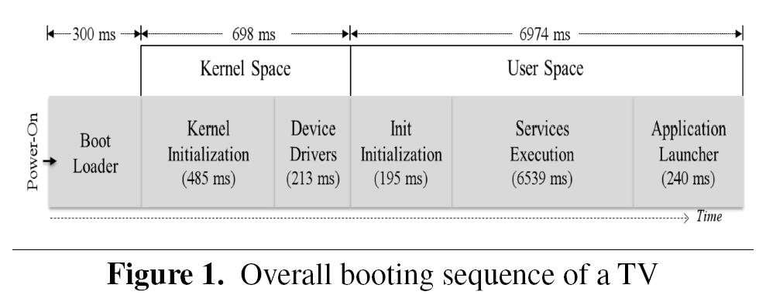
Overall Booting Sequence of TV
7 S
0.7 S
Overall booting procedure with timing information of Tizen TV before this work
8s boot time with optimization techniques of prior works
Notes:
We had reduced the booting time of the digital television from 16 seconds to 8 seconds thanks to the existing a lot of studies.
However, we could not reduce the booting time of the devices with the existing approaches from the 8 seconds. So, we had to find new solution to resolve this problem.
Actually, we needed to complete the booting time of the device within 3seconds according to the customer satisfaction survey in the field.

Slide 9
Two Execution Order Mechanisms
Out-of-order
Substantially faster but also more complex.
(e.g. Execution failure of service daemon)
Services will change order of boot sequences to keep dispatching.
In-order
Substantially guarantee order of boot sequence but also slow.
(e.g. delay of an former application execution)
It stops issuing applications because of dependencies when the previous application can not be dispatched.
Notes:
There are two different execution order mechanisms at boot time.
First is out-of-order mechanism. It can execute the services substantially faster at boot time. However, it will be possible to fail the execution of the service daemon because of the absence of dependency structure.
Second is in-order mechanism. It can guarantee execution sequence of the service daemons thanks to the dependency design. However, booting scheme based on this mechanism stops starting applications because of the dependencies when the previous application can not be dispatched in time.

Slide 10

Evolution of Booting Scheme
Single Process
Multi Process
Multi Threaded
Synchronous/Parallelism
Start
socket
socket
socket
parallelism
socket+dbus+readahead
fork(2)
readahead
rcS
udev
dbus
dbus
readahead
dbus
media1/2/3
media
synchronous
udev
notifier
udev
pthread_create(3)
Xorg
readahead
launcher
execve(2)
media1 2 3
wallpaper
Xorg
media1
Xorg
Xorg
launcher
widget
service provider
launcher
media2
launcher
widget
Context service
End
Managing CPU scheduling, I/O scheduling, and memory pressure
Creation & termination of processes
Notes:
하지만, 커널은 보통 모든 유저 프로세스를 동등하게 처리하고, 각각의 유저 프로세스를 처리할 충분한 정보를 가지지 못한다.
이러한 격차를 메꾸기 위해 최근의 init scheme에는 각 프로세스의 특성을 기반으로한 정책을 가진 자원 관리 메커니즘이 추가되었다.
Since the appearance of BSD init daemon , booting schemes have evolved continuously to initialize OS services correctly at boot time
In sequence, single process based booting scheme, Multi process based booting scheme, multi thread based booting, and synchronous & parallelism based booting scheme.
Up-to-date booting schemes have started managing CPU scheduling, I/O scheduling, and memory pressure, as well as the creation and termination of the process, because the kernel usually treats every user process equally.
---------------------------
Such functionality has been traditionally managed solely by the kernel. However, evolution of booting scheme has generated because the kernel usually treats every user process equally.

Slide 11
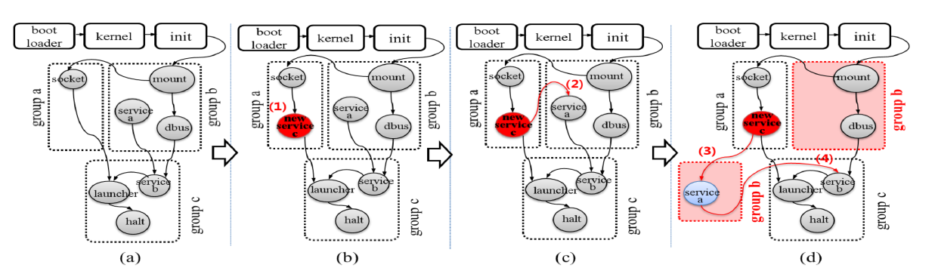
Issues of Modern Booting Scheme
cycle
New service c introduces a cycle between group a and group b, and that cycle forces group b to be split
Increased complexity of dependency relations by adding a new service
Notes:
There are an issue of modern booting scheme based on the in-order mechanism. Here is simple dependency relationship among the services at boot time.
When the new service will be created by developers, new dependency will be also created.
As a result of that, unexpected situation can be made by new service c. By adding a new service c, it make a cycle between group a and group b
and this cycle forces group b to be split. In this case, we can simply resolve this issue by optimizing the incorrect dependency relationship.
However, Let’s see the more complicated dependency situation in real environment at boot time on next page.

Slide 12
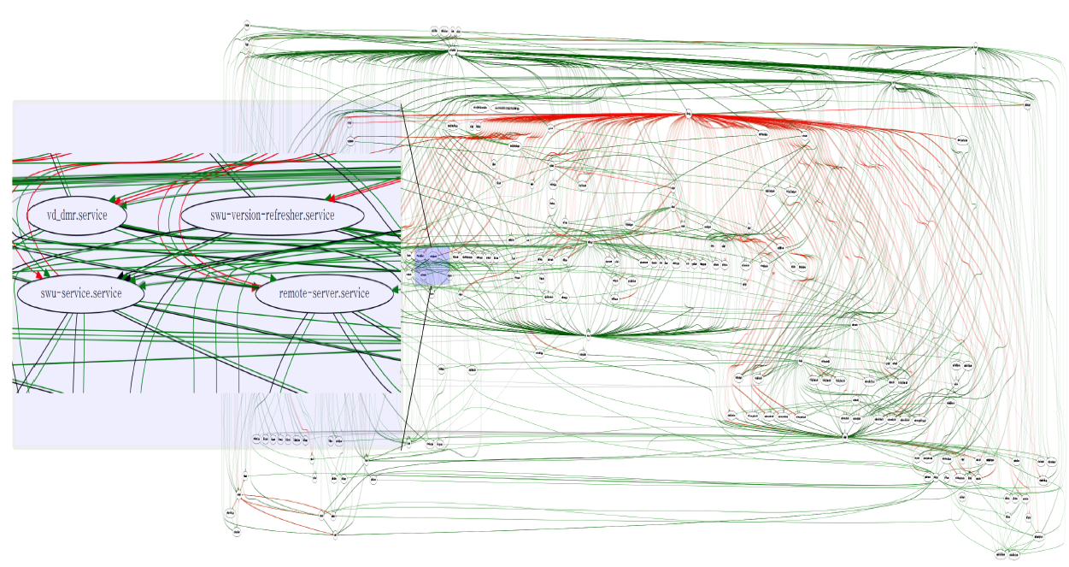

Dependencies of 136 Services at Boot Time
Dependencies among 136 services in open-source Tizen TV OS.
Red lines are strong dependencies and green lines are weak
Notes:
How about this dependency graph? This graph shows that there are too many dependencies among 136 services in the real digital television based on Tizen OS.
In this case, we had needed too many times to optimize the dependency relationship of the service to meet fast boot of the device.

Slide 13
Background
Booting Booster
Evaluation
Notes:
So, we designed and implemented the booting booster framework.

Slide 14
Architecture of Booting Booster (BB)
Core Engine: kernel-space BB components
Bootup Engine: user-space BB components to run its own startup service
Service Engine: user-space BB components to control booting-critical services
Applications & Services
(4)
Booting Booster Group
Tools
(5)
Service
Engine
Booting Booster Group
Isolator
Booting Booster Manager
Service Analyzer
Pre-parser
(1)
user-space
(3)
Deferred Executor
RCU Booster
Control
On-Demand Modularizer Control
Boot-up
Engine
(2)
SysFS
ProcFS
Core
Engine
kernel-space
RCU Booster
On-demand Modularizer
Control flow
Notes:
On-demand Modularizer : 부팅 시에 중요하지 않은 내장 커널 모듈의 초기화 지연, 필요한 공간만큼의 메모리만 초기화
RCU Booster : RCU 를 개선하였음 – 기존의 Ticket Spin Lock 을 Memory Barrier 및 Mutual Exclusion을 사용하여 waiting 쓰레드를 spin하는 대신 sleep 하게 만듦 다시말해 CPU를 다른 쓰레드를 위해 release함,
만일 동시에 lock 을 요구한다면 기존에 비해 CPU 오버헤드가 크기 때문에 선택적으로 사용, lock을 두고 경쟁하는 쓰레드가 0 혹은 1 이면 기존 방식이 더 빠름
On-Demand Modularizer Control : On-demand Modularizer 가 지연시킨 작업이 유저공간에서 필요하게 되면 실행시키는 역할, 메모리
RCU Booster Control : RCU Booster를 실행하거나 실행하지 않도록 하는 역할
Deferred Executor : OS 서비스를 시작하는데 필요하지 않은 systemd 의 작업을 부팅 이후에 시작하도록 지연시킴 ex: 컴퓨터 ID, 호스트 이름, 테스트, 디버그 목적의 디렉토리 등
Booting Booster Group Isolator : BB 그룹에 속할 서비스를 판별하고 고립시킴 – 의존성을 분석하여 – 이는 사용자가 부팅 완료라고 인식할 수 있게 하는 서비스(ex: 리모컨 입력, TV 화면을 나타내는 서비스 등)
Booting Booster Manager : BB 그룹 서비스 실행, 이때 BB 그룹 이외의 서비스들은 systemd에서 실행중이며 BB 그룹이 우선권을 갖고, 그룹 이외의 서비스들은 지연된다.

Slide 15
Major Goal of Booting Booster (BB)
Deferring tasks that are not crucial determinants of the booting time.
Identifying, isolating, and prioritizing booting-time critical tasks
Adopting booting time-aware synchronization mechanism
Adopting Improved parallelism with more tasks executed in parallel
Pre-processing repeated tasks at build-time.
Improving performance of bottlenecks
Notes:
Our Booting Booster is focusing on resolving the obstacles of fast boot.
1) Deferring tasks that are not crucial determinants of the booting time
2) Identifying, isolating, and prioritizing booting-time critical tasks
3) Adopting booting time-aware synchronization mechanism
4) Adopting Improved parallelism with more tasks executed in parallel
5) Pre-processing repeated tasks at build-time.
6) Improving the performance of bottlenecks

Slide 16
Kernel-Space: Core Engine
Boosted RCU synchronization algorithm:
Blocking lock improves performance in the contended case for accelerating boot-up time (※Refer to the paper for more details)
It incurs greater CPU utilization due to process context switch and scheduling cost
On-demand Modualarizer:
Modularizes built-in kernel components, and defers the initialization of non-critical built-in kernel components until completing the primary boot sequence
Notes:
In kernel space, Core engine consists of boosted RCU synchronization algorithm and on-demand modualarizer.
(발표시간이 여유가 있을것 같으면, 간단히 2개의 컴포넌트에 대해서 설명하도록 한다.) – 가능할듯!!!!

Slide 17
User-Space: Bootup & Service Engine
Bootup Engine
It is in charge of faster initialization of booting scheme and enabling the facilities of kernel-space Core Engine
Service Engine
It has 1) tools for system administrators and 2) Booting Booster Group Isolator and 3) Booting Booster Manager, which are implemented in booting scheme and accelerate booting sequence
Notes:
In user-space, there two different engines like bootup and service engine.
Bootup engine is responsible for faster initialization of booting scheme and enabling kernel facility.
Service engine is in charge of controlling booting time critical services and booting time non-critical services.

Slide 18
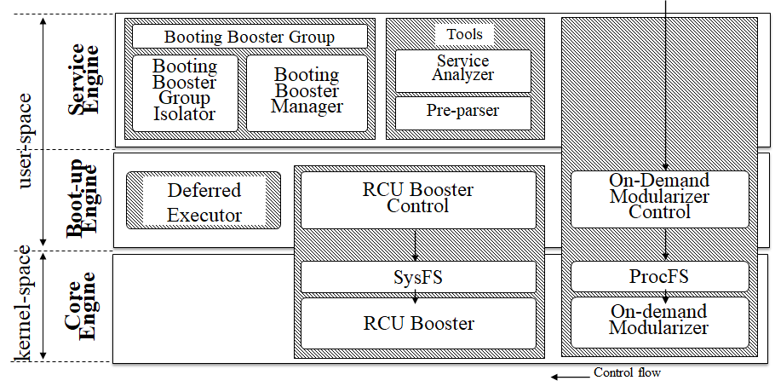
On-demand Modularizer
부팅 시 필요한 공간만큼만 메모리 초기화
부팅 시에 중요하지 않은 커널의 구성요소를 모듈화
해당 모듈들의 초기화를 지연시킴
모듈들을 동시에 초기화
18

Slide 19
RCU Booster
RCU 개선
기존 RCU의 Ticket Spin Lock 을 Memory Barrier 및 Mutexes를 사용하여 waiting 쓰레드를 spin하는 대신 sleep 하게 만듦
다시 말해 다른 쓰레드를 위해 CPU 를 release했다.
19

Slide 20
RCU
RCU : Read-copy-update
기존의 객체를 변경하는 대신 새로운 불변 객체를 만들어 쓰레드의 안전성을 확보하는 것
RCU로 보호되는 객체를 변경하려는 경우, 객체를 직접 변경하는 대신 새로 할당한 메모리 영역에 객체를 복사한 뒤 새로 만든 객체를 변경
읽기 오버헤드 거의 없음

Slide 21
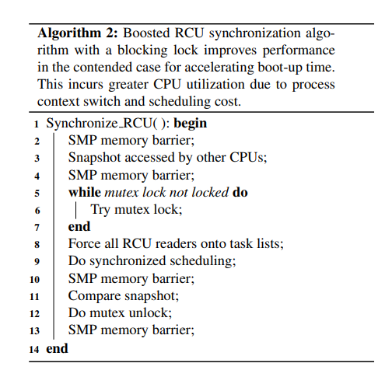
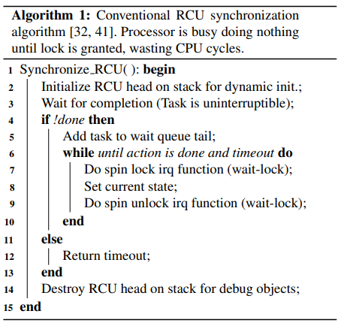
기존 RCU
Boosted RCU

Slide 22
On-demand Modularizer Control
On-demand Modularizer 가 지연시킨 작업이 어플리케이션 혹은 OS 서비스에서 필요할 경우, 실행시키는 역할
22

Slide 23
RCU Booster Control
RCU Booster를 유저 공간 agent로써 활성화 및 비활성화함
비활성화 조건은 관리자가 결정 가능(CPU 사용률 등을 고려하여)
보통 Boot-up Engine이 실행되자마자 RCU Booster 실행, 부팅이 완료되면 RCU Booster 종료
23

Slide 24
Deferred Executor
OS 서비스를 실행하는데 필요하지 않은 systemd 작업을 부팅 완료까지 지연시킴
지연된 작업
logging
커널 모듈 및 호스트 이름과 장치 ID를 설정하는 절차
테스트 및 디버그 목적의 디렉토리
24

Slide 25
Booting Booster Group Isolator
BB 그룹
부팅에 중요한 역할을 하는 서비스
사용자가 부팅 완료라고 인식하게 하는 서비스
ex : 리모컨 입력 처리, TV 화면 보여주기 등
부팅 완료의 정의에 대한 의존성을 분석
BB 그룹에 해당하는 서비스를 식별하고 BB그룹에 포함
25

Slide 26
Booting Booster Manager
BB 그룹 내부 프로세스를 실행
이 때, BB 그룹 이외의 프로세스는 systemd 에서 실행
BB 그룹 내부의 프로세스들이 우선순위를 가지게 함
26

Slide 27
Tools
시스템 관리자의 부팅 시간 최적화를 돕기 위한 도구
Service Analyzer
패키지 구성파일을 읽어 서비스간의 관계 조사
올바르지 않은 관계 정의 보고(ex: circular dependency)
Pre-parser
서비스 구성 파일을 사전 분석, systemd가 이를 읽고 부팅 시 구성 파일 읽기 및 구문 분석을 건너뛸 수 있도록 함.
27

Slide 28
Background
Booting Booster
Evaluation

Slide 29
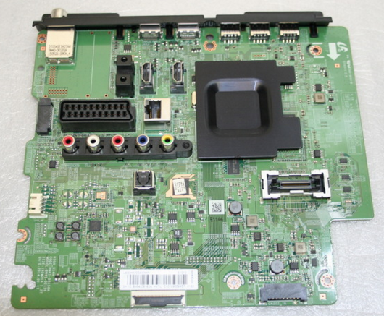
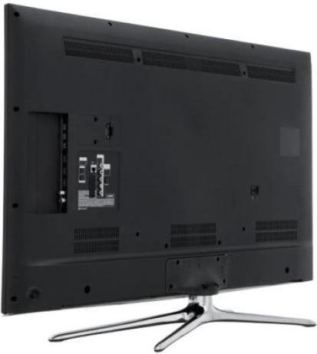
Experimental Environment
Test device: UE48H6200 (48” UHD display panel)
CPU/RAM: Application processor with four Cortex -A9 CPU cores / 1GiB RAM
Platform: Tizen 2.3+ TV profile, Linux 3.10 kernel , Systemd v208 init.
(Systemd was selected as default ‘init’ daemon on Fedora 20, RHEL7, and Ubuntu 14.10)
UE48H6200
4 Cortex-A9 CPU Cores & 1GiB RAM
Notes:
We evaluated the effect of the our proposed system in Tizen software platform based on Linux kernel.

Slide 30
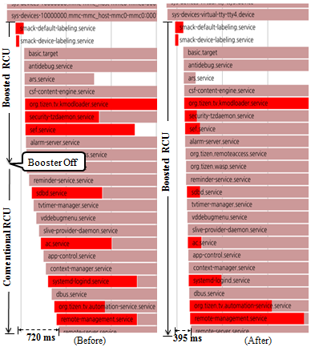
Boosting Service Start Time w/ RCU Booster
Applications & Services
Service Engine
N
Q
(5)
(5)
user-space
Boot-up Engine
N
No
(4)
Yes (4)
Q
Boosting
Core Engine
(3)
N
(1)
N
(2)
Init kernel-thread Switcher
Q
Q
kernel-space
On-demand
Modularizer
RCU Booster
(a) Sequential operation flow of three engines in Booting Booster (BB) - N: Normal Boot
- Q: Quick Boot
Time
Time
(b) Graphs showing effects of RCU Booster
Notes:
Let’s see the effect of the RCU Booster at boot time.
Right graph show the sequential operation flow of three engines in booting booster.
By introducing our RCU Booster, We could dramatically reduce the start time of the services from 700ms to 400ms.

Slide 31
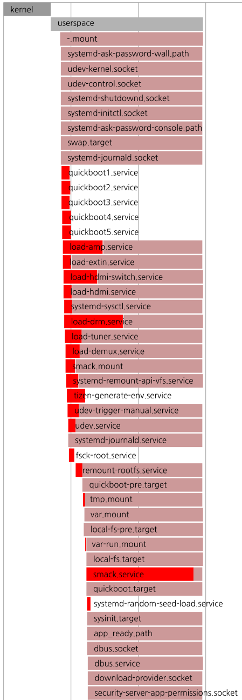
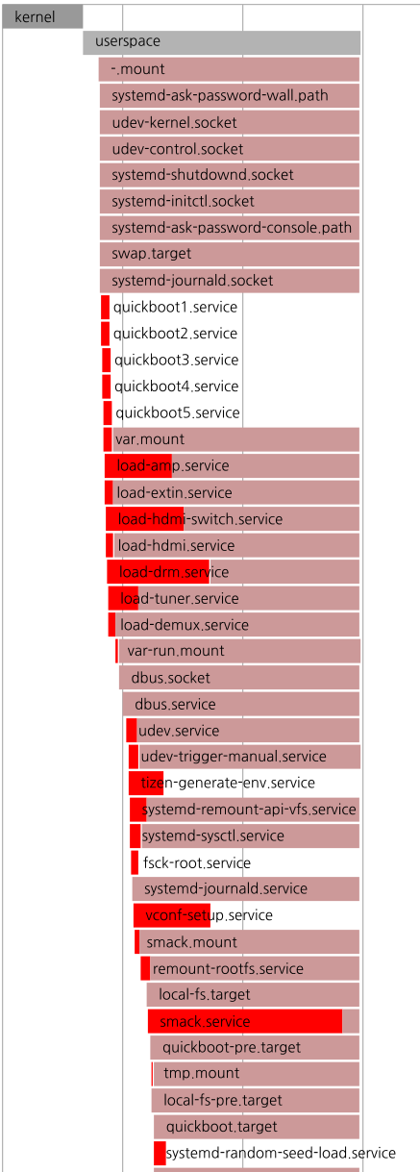
How Does BB Group Isolator Work?
Effect of BB Group Isolator: Adding mount service “var” into BB Group to advance launching time of booting critical dbus service (standard IPC)
Booting Booster
Group
Booting Booster
Group
1
var.mount
Dependency
relationship
2
dbus.service
1
var.mount
Dependency relationship
2
dbus.service
450 ms
195 ms
Time
Time
Notes:
Let’s see how booting booster group isolator works.
//For fast boot, dbus servcie is the booting time critical service. It is dependent on the execution time of the mount service var.
//The right graph shows the effects on partial execution of BB Group by adding mount service var into BB Group to advance the launching time of dbus service
//We could optimized the start time of the dbus service without any application modification from 400ms to 200msc

Slide 32
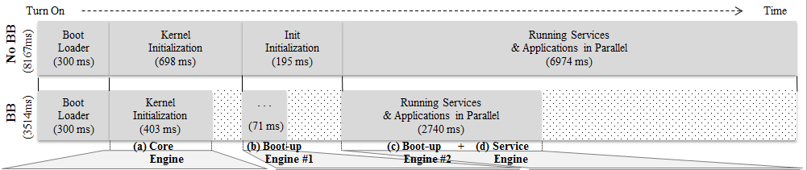
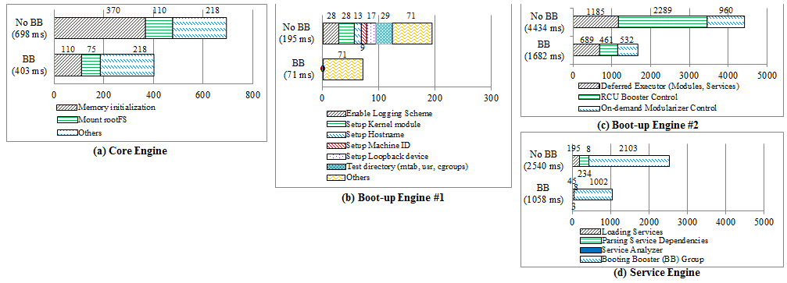
System-wide Experimental Result
Boot-Time Comparison: Conventional (No BB) VS. BB
295ms
124 ms
4234 ms
8.1 s →3.5 s
Notes:
We also evaluated the system-wide experiment before deploying our booting booster based commercial digital TV sets.
We could drastically reduced the booting time of the existing digital TV sets from 8.1 s to 3.5 s.

Slide 33

Demo: Booting Time (No-BB VS BB)
Notes:
Let’s see the boot time of the devices after applying Booting Booster in real digital TV.
### PLAY VIDEO ###
The below display shows the booting time of our proposed system.
And then, the existing system will be finished after long seconds.

Slide 34
Conclusions
Booting time is extremely significant performance metric in many consumer electronics devices
To accelerate booting, Booting Booster (BB); Core engine, Boot-up engine, and Service engine
Boosting execution time of services daemons
Isolating BB Group from dependency mechanism
Lightweight-weight initialization with Pre-parser
Achieving cold boot in 3.5 s (compared to 8.1 s without BB)
BB was adopted in all 2015+ Samsung Smart TV models, Open-source software at http://opensource.samsung.com
Notes:
So far. In summary, Booting time is extremely important performance metric in many consumer electronics devices
To accelerate booting time of the digital TV sets, we designed and implemented Booting Booster that consists of Core engine, Boot-up engine, and Service engine
BB was adopted in all 2015 and 2016 Samsung Smart TV models. It is also available at at http://opensource.samsung.com as fully open-source software

Slide 35
Thanks
Notes:
Thank you for listening the presentation.

Slide 36
FAQ
Who cares about fast-boot of CE devices? Can you do it for all CE devices?
Sounds too good. Are there any limitations?
I totally don’t get why you are doing this.
Why don’t you apply “cold boot “ techniques for smart phone?
How about you attach the battery into TV with suspend-to-ram?
Notes:
No question? Here is FAQ for the audience.

Slide 37
Answer
There are a lot of research papers for fast-boot. But, the existing studies are not enough to get faster booting. We are challenged to make a novel solution to overcome this new hurdle for a big jump.
We still need to study in order to find good approaches in new system environments.
We focus on the cold-boot based fast-boot techniques for solving the complaints of customers from plug-off situation.
In case of a smart phone, customers don’t try to turn-on the smart phone in cold boot mode, because they always end up charging the battery. So, suspend-to-ram is just perfect for phone in real environment.
Manufacturers are already deploying Battery-powered LED TV. But, battery support is not suitable because lifespan of TV (7 years) is longer than the smart phone. Over all, battery component results in higher price of popular TV.
Notes:
Here are the answers on the FAQ of previous page.
* Battery-powered LED digital TV:
http://www.engadget.com/2010/11/29/toshibas-32-inch-power-tv-runs-for-2-hours-on-integrated-batter/ http://www.lg.com/africa_en/tvs/lg-32LB552R-TB (2011, LG LED TV 32LB552R-TB)

Slide 38
Related work
Approach | Pros. | Cons.
NetBSD ‘rc.d ’ system (USENIX ATC 2001) | Simple start-up sequence Dependency ordering Manipulation of individual services | Editing of start-up script(e.g. /etc/rc) is dangerous Dynamic dependency ordering make difficult fast boot requirement
Advanced Boot Scripts (Linux Symposium 2002) | Dependency-based booting scheme Parallel execution of processes Support concept of run-levels | Not handle the dependency complexity Slow boot because in-order mechanism is based on dependency Not recognize limited resource env. of mobile devices
Solaris Service Management Facility (USENIX LISA 2005) | Dependency based booting technique. Service management facility to reduce increasing complexity of s/w stacks | Not handle the dependency complexity Not consider multi-core architecture. Slow boot because in-order mechanism is based on dependency
Beyond init: Systemd (Linux Con 2011) | Dependency based booting technique Parallel execution of processes | In-order mechanism is based on dependency Can’t optimize service files easily for fast boot Not recognize limited resources of mobile
?
Our Approach | Mutex-based RCU Booster On-demand Modualarizer Isolated group for fast boot Light-weight booting scheme
* SMF: Service Management Facility

